Slide 1


The Future
How Do I Become A CBP Trusted Trader?
Liberty International, Inc
The Power Of Choice
Sean McClung
Director of Operations and Compliance

Slide 2

Quick Overview of Objectives
What is a Trusted Trader?
What Is The Importer Self Assessment Program?
Benefits of ISA Membership
Leveraging Your Relationship with Liberty To Get ISA Certified
How Do I Leverage What I’m Already Doing?
  First In a Series… Let’s Formalize Your Record Keeping
Liberty International Inc. www.libertyint.com

Slide 3
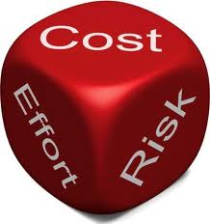
Why Have A Trusted Trader Program?
CBP’s goal is to partner with importers who can demonstrate their readiness to assume the responsibility to manage and monitor their compliance through self-assessment.
Importers who are accepted into the Trusted Trader
program will receive tangible benefits, while at the same time allow CBP to re-direct valuable
resources to focus on high-risk,
unknown importers.
Liberty International Inc. www.libertyint.com
Notes:
What Trusted Trader is about is that CBP has limited resources just like us… This is about risk segmentation… CBP wants to take the good guys off the table… Look into the audience and state “like all of you.” you took the time to come here… they want to give the good guys “green lane” status…. Real tangible benefits that result in faster clearance and fewer exams so they can focus their time on the unknowns and the bad guys. That word unknown is very important because right now even though all of you are taking the time to do things the right way if you are not a member of a trusted trader program CBP sees you as an unknown. So you are doing the work and not getting the benefits. We want to change that together.

Slide 4

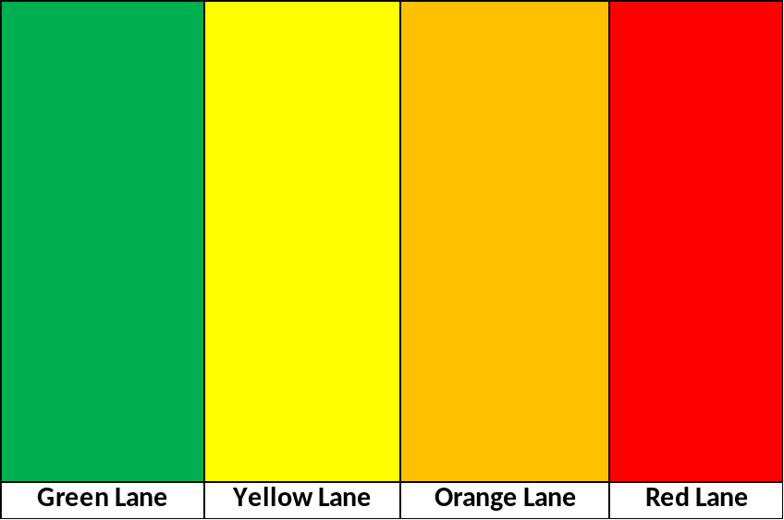
Trusted Trader
Liberty International Inc. www.libertyint.com

Slide 5



What Is A Trusted Trader?
CBP currently defines “trusted traders”
as companies participating in the Customs-Trade Partnership Against Terrorism (C-TPAT) program (Tier II or Tier III) and the Importer Self-Assessment (ISA) program.
CBP is currently redefining the meaning of trusted trader. They are developing a comprehensive trusted trader program that will include
  C-TPAT for import and export (Security),
  ISA (Trade Compliance),
  IPR (e.g. trusted trader benefits for licensees of brands),
  PGA (FDA,CPSC, F&W, etc.)
Liberty International Inc. www.libertyint.com
Notes:
This program will be all voluntary. You pick and choose what works best for you based on your company needs.

Slide 6
What Is ISA?
The Importer Self Assessment Program
(ISA) is a voluntary trade facilitation
partnership program for trade compliant companies that want to assume responsibility for managing their own compliance, in exchange for less CBP oversight.
The Importer Self Assessment (ISA) program is built on the knowledge, trust, and willingness to maintain an ongoing CBP/importer relationship that is mutually beneficial to both parties.
Liberty International Inc. www.libertyint.com
Notes:
What we are going to talk about today is ISA and how do we get you ISA certified.

Slide 7

Benefits of Membership!
Less Customs Intrusion:
  Exemption from comprehensive, regulatory audits
  With regard to prior disclosures, if CBP becomes aware of errors in which there is an indication of a violation of 19 U.S.C. 1592 or 1593a, CBP will provide a written notice to the importer of such errors and allow 30 days from the date of the notification for the importer to file a prior disclosure pursuant to 19 CFR 162.74.
  In the event that civil penalties or liquidated damages are assessed against an importer, the importer’s participation in ISA will be considered as a mitigating factor in the disposition of the case.
Closer Relationship with CBP:
  The importer will have access to key liaison officials and will be assigned a national account manager.
  The importer will be entitled to receive free of charge entry summary trade data (ITRAC Data), including analysis support.
Liberty International Inc. www.libertyint.com
Notes:
These are the benefits of membership in the current ISA program – there may be additional benefits in the future. CBP may be expanding the amount of data that they share and the type of data they share such as summary data about the products that you import or same brand that you import as a form of market intelligence.
The National Account Manager is now an Account Executive if you become a member of one of the Centers of Excellence. ISA membership gives you preferential consideration for membership in the CEE’s. It also allows you to participate in varies pilot programs that Karen reviewed during her presentation.

Slide 8

Requirements of Membership…
Be a member of C-TPAT;
Complete an ISA Memorandum of Understanding (MOU) and Questionnaire;
Agree to comply with all applicable CBP laws and regulations;
Maintain an internal control system that is designed to provide reasonable assurance of compliance with CBP laws and regulations:
Perform annual risk assessments to identify risks to compliance with CBP laws and regulations.
Design and execute annual self-testing plan in response to identified risks.
Implement corrective action in response to errors and internal control weaknesses disclosed by self-testing
Liberty International Inc. www.libertyint.com
Notes:
These are the current requirements of ISA membership… These may be changing…

Slide 9

Requirements of Membership… Cont’d
Maintain results of testing for three years and make test information available to CBP upon request;
Make appropriate adjustments to internal control;
Maintain an audit trail from financial records to CBP declarations, or an alternate system that ensures accurate values are reported to CBP.
Make appropriate disclosures.
Submit an annual notification letter to CBP.
Notify CBP of major organizational changes
as soon as possible
Liberty International Inc. www.libertyint.com
Notes:
I listed these here so that you can go through them later – I’m not going to go through them in detail now. But generally speaking what you are doing is formalizing your compliance processes in writing and conducting your own internal risk assessments and audits. CBP calls these audits self tests. Implementing corrective actions to correct any issues you find.

Slide 10



It Will Get Easier!!!
CBP is formalizing the program right now that will allow Customs Brokers to pre-certify their clients for ISA membership.
Essentially we’ll help you set up processes and complete the necessary applications to CBP for ISA membership
Liberty International Will Be Able To Help You Comply!!!
Liberty International Inc. www.libertyint.com
Notes:
Essentially what we are saying is that this program is about leveraging and formalizing what you are already doing to stay compliant in a way that gets you real, tangible benefits from CBP.
So to get us started this presentation is the first in a series of presentations that we will be offering to help you formalize your import compliance program, whether you choose to get ISA certified or not

Slide 11

How Do I Get Started?
10 Best Practices
Establish a record-keeping program – (Control Activities)
Develop compliance requirements for suppliers – (Control Activities)
Develop formal policies – (Control Activities)
State compliance and cost goals – (Risk Assessment)
Have management’s commitment – (Control Environment)
Access executives for needed resources – (Control Environment)
Establish training programs – (Information & Communication)
Create compliance group – (Information & Communication)
Partner with Customs & Border Protection – (Information & Communication)
  Enhance partnership by participating in voluntary programs such as C-TPAT, ISA, ACE, etc.
Conduct internal control reviews – (Monitoring)
Liberty International Inc. www.libertyint.com
Notes:
These are 10 best practices that have been learned through the ISA pilot program.
I am going to focus on establishing a record-keeping program today and we will cover the other topics in future seminars that continue this series forward.

Slide 12

What Are Records?
In Part 163, the term “records” means any
information made or normally kept in the ordinary course of
business which pertains to Customs related activities:
Any importation, declaration or entry
The transportation or storage of merchandise carried or held under bond into or from the customs territory of the United States
The filing of a drawback claim
The completion and signature of a NAFTA export Certificate of Origin pursuant to Part 181
The collection and payment of fees and taxes to CBP
Any other activity required to be undertaken pursuant to laws or regulations administered by CBP
Liberty International Inc. www.libertyint.com

Slide 13

Make Sure You Are Getting What You Need!
Broker Invoice
CBP Form 3461
CBP Form 7501
Commercial Invoice
Packing List
Transportation Document (AWB/BOL)
Copies of any special documents…
  Assist supporting documents
  GSP/NAFTA, etc.
Liberty International Inc. www.libertyint.com

Slide 14
How Long Do I Have To Keep Records?
As a general rule, any record required to be made, kept and rendered for examination or inspection under Part 163 must be kept for 5 years from the date of entry (which includes a reconciliation), if the record relates to an entry, or 5 years from the date of the activity which required creation of the record.
But, if another provision of the CBP Regulations sets forth a different retention period for a specific type of record, the other provision controls. For example:
181.12 requires that all supporting records relating to NAFTA Certificates of Origin for exports be maintained for 5 years from the date the certificate was signed.
For A Detailed Explanation of Record Keeping Please See CBP’s Informed Compliance Publication on Record Keeping:
http://www.cbp.gov/linkhandler/cgov/trade/legal/informed_compliance_pubs/icp027.ctt/icp027.pdf
Liberty International Inc. www.libertyint.com

Slide 15

Does Your Record-Keeping Process Work?
Can you find entry records in a timely manner? By entry number?
Do you have an audit process to confirm completeness of records?
Is your record keeping
process documented?
Liberty International Inc. www.libertyint.com

Slide 16
How Do I Get Started?
10 Best Practices
Establish a record-keeping program – (Control Activities)
Develop compliance requirements for suppliers – (Control Activities)
Develop formal policies – (Control Activities)
State compliance and cost goals – (Risk Assessment)
Have management’s commitment – (Control Environment)
Access executives for needed resources – (Control Environment)
Establish training programs – (Information & Communication)
Create compliance group – (Information & Communication)
Partner with Customs & Border Protection – (Information & Communication)
  Enhance partnership by participating in voluntary programs such as C-TPAT, ISA, ACE, etc.
Conduct internal control reviews – (Monitoring)
Liberty International Inc. www.libertyint.com
Notes:
These are 10 best practices that have been learned through the ISA pilot program.
I focused on establishing a record-keeping program today and we will cover the other topics in future seminars that continue this series forward.

Slide 17
Key Takeaways…
This Presentation Is The First In a Series on
Import Compliance
The Trusted Trader Program Is The Future of Trade Compliance
  Even If You Do Not Want To Participate You Should Still Have Incorporated The Concepts We Discussed Today Into Your Corporate Compliance Program
Need Help Getting Started…
Call Liberty!
We Are Here To Help…
Liberty International Inc. www.libertyint.com
Notes:
Start by getting executive buy in. Identify what you are doing today and document it. Let’s work together and get you the benefits you deserve as compliant importers and exporters.

